Slide 1
Crypto Forecasting
Naviotech
Data Science Internship Project
Name: Sudipta Kar
Internship: Naviotech Data Science Internship
Project: Crypto Forecasting
Date: 26 July 2026

Slide 2
INTRODUCTION
Cryptocurrency is a digital financial asset whose market prices fluctuate continuously.
Accurate price forecasting is important for market analysis and informed decision-making.
Time series forecasting uses historical data to identify trends and estimate future values.
This project applies the ARIMA (AutoRegressive Integrated Moving Average) model to forecast future cryptocurrency prices.
Python and its data science libraries were used for data analysis, visualization, and model development.

Slide 3
OBJECTIVES
Analyze historical cryptocurrency price data.
Perform data preprocessing and exploratory data analysis.
Identify trends and patterns in the dataset.
Develop an ARIMA-based forecasting model.
Predict future cryptocurrency prices using historical observations.
Evaluate the effectiveness of time series forecasting techniques.

Slide 4
DATASET DESCRIPTION
Dataset Name: BTCUSD_1_MIN_data.csv
The dataset contains historical cryptocurrency trading records collected at one-minute intervals. It includes market information required for time series forecasting.
Features
Timestamp
Open Price
High Price
Low Price
Closing Price
Trading Volume
Source: Kaggle Historical Cryptocurrency Dataset
URL:https://www.kaggle.com/datasets/mczielinski/bitcoin-historical-data

Slide 5
TOOLS AND TECHNOLOGIES USED
Development Environment
Software | Purpose
Python | Programming Language
Jupyter Notebook | Development Environment
Pandas | Data Manipulation
NumPy | Numerical Computing
Matplotlib | Data Visualization
Statsmodels | ARIMA Model

Slide 6
METHODOLOGY
Historical Cryptocurrency Dataset
Data Cleaning
Data Preprocessing
Exploratory Data Analysis(EDA)
Moving Average Analysis
Time Series Decomposition
ARIMA Model Development
Forecast Generation
Result Analysis

Slide 7
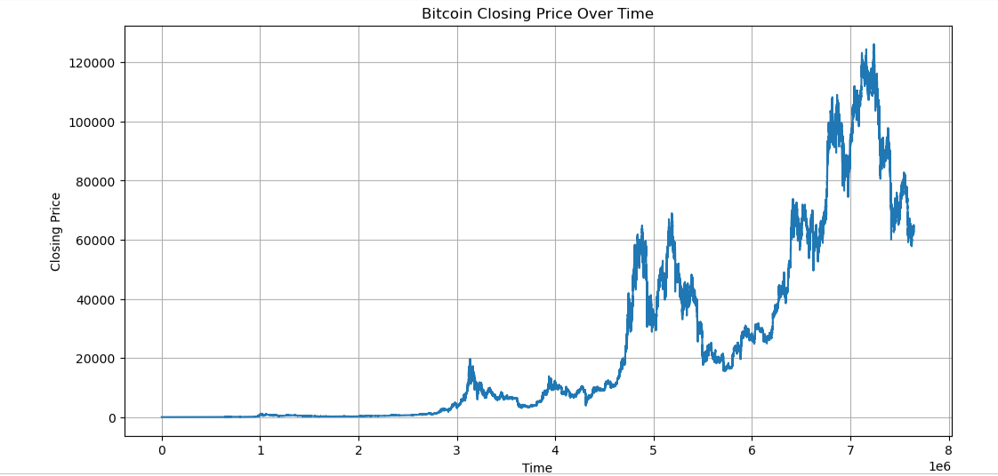
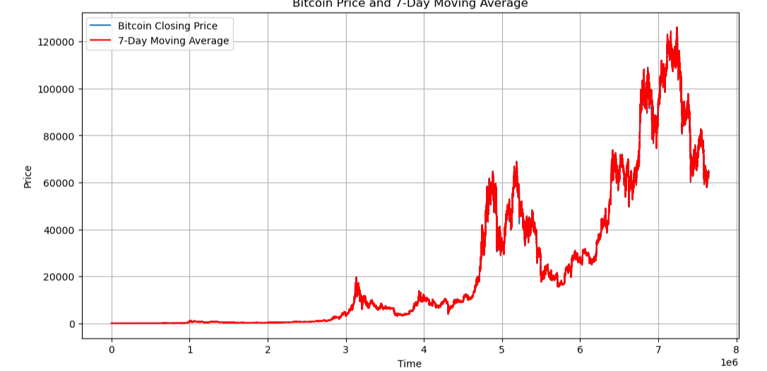
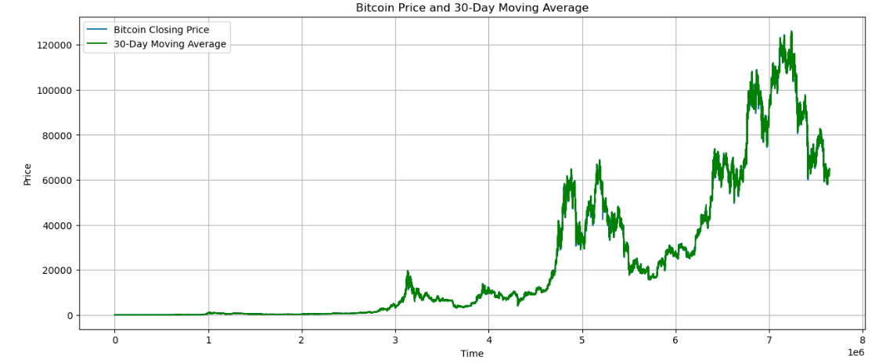
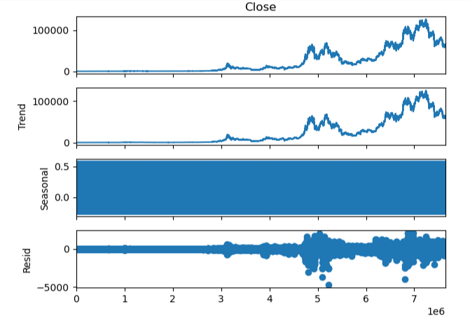
EXPLORATORY DATA ANALYSIS(EDA)
Closing Price Over Time: Displays the variation in cryptocurrency closing prices over the historical period. The graph shows periods of growth, decline, and high volatility.
7-Day Moving Average: Smooths short-term fluctuations and highlights recent price trends.
30-Day Moving Average: Provides a smoother long-term trend by reducing short-term noise in the data.
Time Series Decomposition: Separates the series into four components:
Observed: Original closing price data.
Trend: Overall long-term movement in prices.
Seasonal: Repeating patterns in the data (very weak in this dataset).
Residual: Random variations remaining after removing the trend and seasonal components.

Slide 8
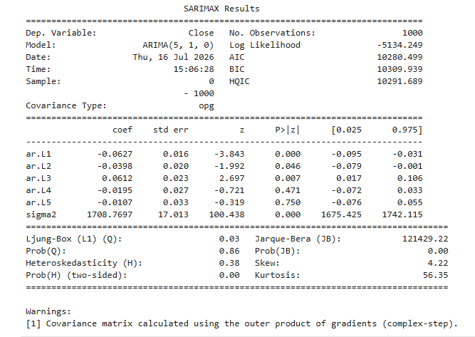
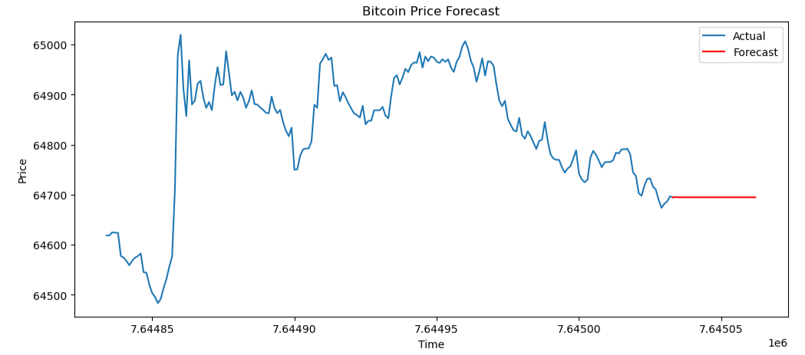
ARIMA MODEL
ARIMA Summary
ARIMA Forecasting Model
Model Used
ARIMA (5,1,0)
Why ARIMA?
Suitable for time series forecasting.
Captures autoregressive relationships.
Uses differencing to remove non-stationarity.
Generates forecasts based on historical observations.
Forecast Graph

Slide 9
RESULTS
Forecast Results
The developed ARIMA model successfully generated future cryptocurrency price forecasts based on historical market data.
Key Findings
Historical price trends were successfully modeled.
Future price values were predicted.
The forecasting graph illustrates expected future market movement.
The model demonstrates the practical application of statistical forecasting methods.

Slide 10
CONCLUSION AND FUTURE SCOPE
Conclusion
This project demonstrates the successful implementation of the ARIMA model for cryptocurrency price forecasting.
Historical market data was analyzed, visualized, and used to generate future price predictions.
The project highlights the usefulness of statistical time series models in financial forecasting.
Future Scope
Integrate real-time cryptocurrency data.
Compare ARIMA with advanced deep learning models such as LSTM.
Develop a Flask-based web application for live forecasting.
Improve prediction accuracy through parameter optimization.

Slide 11
THANK YOU
Thank you for your valuable time and consideration.
Crypto Forecasting Using ARIMA Model
Submitted by:
Sudipta Kar

